Slide 1
Hill Climb Racing
Group name: ASI (Asjid, Subhani, Ibrar)
Group members: (Asjid Tahir p19-0085)
( Hasaan Subhani p19-0084)
(Ibrar Babar p19-0104)

Slide 2
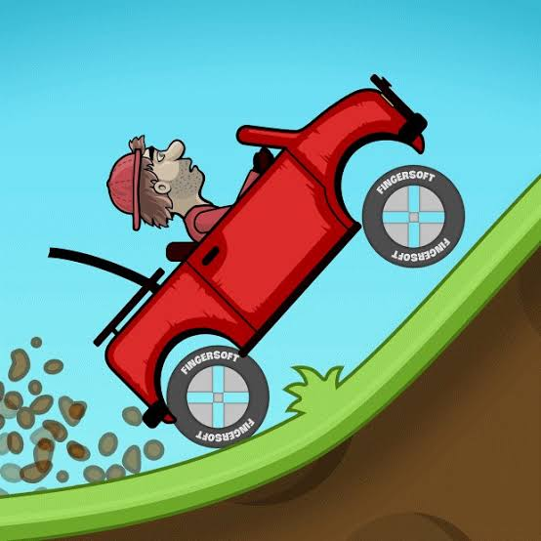

Slide 3
INTRODUCTION
Hill Climb Racing is a Physics based game.
This game is released by the Finnish studio Fingersoft for Android and IOS.
Hill Climb Racing follows the story of an aspiring uphill racer, Newton Bill.
This is a physics-based driving game where you help Newton drive up and down a hill while collecting coins and fuel tanks.

Slide 4
Control Key
Gauges for boost and RPM are also shown on the screen.
Helping you keep track of how fast or how slow you are going.
Aside from collecting coins in purchasing car upgrades.
Newton has to collect fuel containers to keep his fuel tank full. If you run out fuel, the game ends.

Slide 5
ENVIRONMENTS
You get to play four hill climbing environments
The countryside.
The desert.
The Arctic.
The moon.
First is countryside level.
Then in order to go next level we should have to gain specific coins asked by game.

Slide 6
IN THE FIELD OF PHYSICS
When car is moving with normal speed on the hills, the car jump a little up but do not remain more time in air due to gravity.
But when car is moving with high speed on the hills, it jump up and remain more time in air at that time its gravitational force fall down, but when we press right key botton the its gravitational force rise up.

Slide 7
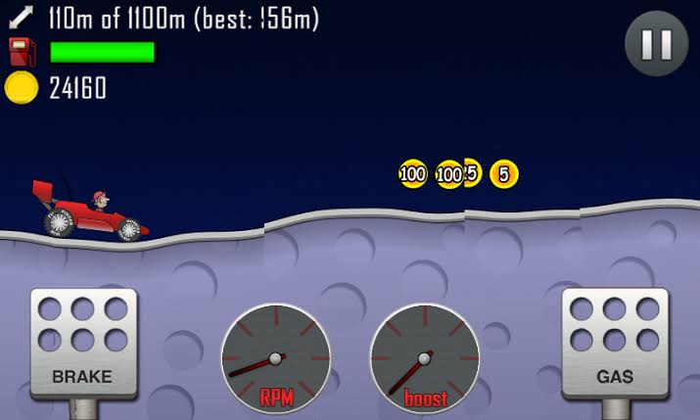

Slide 8
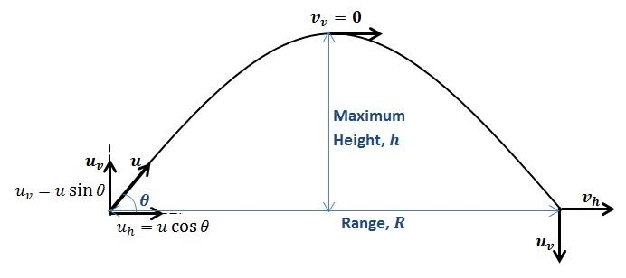
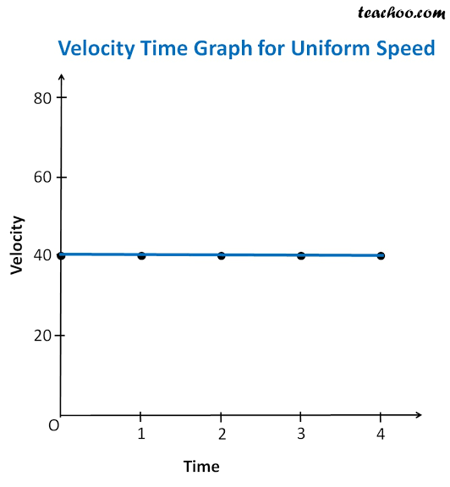
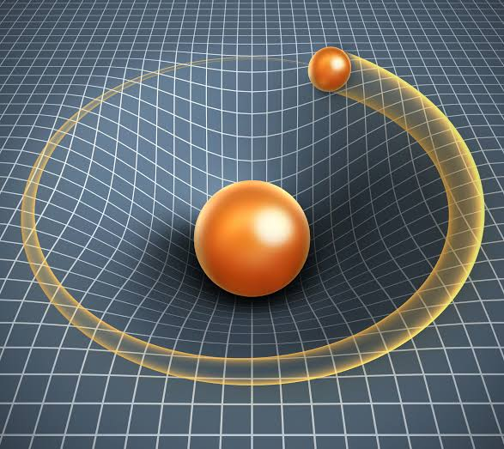
PROJECTILE MOTION
.UNIFORM VELOCITY
GRAVITY CONTROL

Slide 9
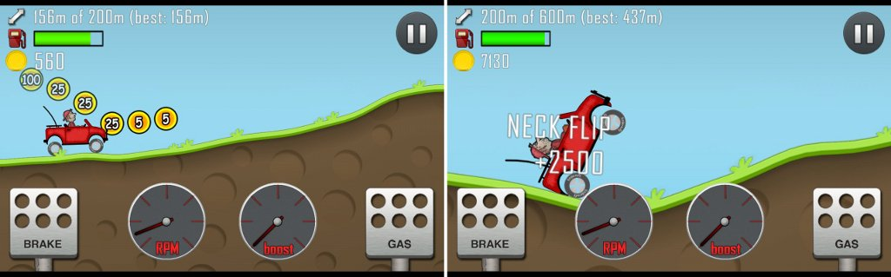

Slide 10
Falling Down of CAR
When speed of car rising up then a stage come when we cannot control car after applying keys.
There are many applications of physics applied on it, due to this reason car motion cannot be controlled.
Car roll down and flipped.

Slide 11


Slide 12
ANY QUERIES ?????? THANK YOU!!!!!!!

